Slide 1
Reinforcement Learning Sequential Decision Making
Understanding Machine Learning

Slide 2
Sequential Decision Making
reinforcement learning (RL):
formalization of sequential decision making (action policy) of software agent interacting with environment
corresponds to search for best (or rather good) action policy to reach a given goal (e.g., win a game)
using learning from examples (data) to guide the search
RL usually more difficult (e.g., non-differentiable as a whole) than supervised learning (which can be seen as “generalized optimization”, often of proxy metric)

Slide 3
Main Elements of RL
goal: find action policy maximizing reward from environment
action policy: exploration-exploitation trade-off
e.g., epsilon-greedy: random exploration at small fraction of the time
off-policy instead of on-policy learning: policy for learning different from current best → exploit in application and explore during learning
feedback from environment: goal-directed, no supervision
scalar reward signal
cumulative and delayed rewards (credit assignment problem)

Slide 4
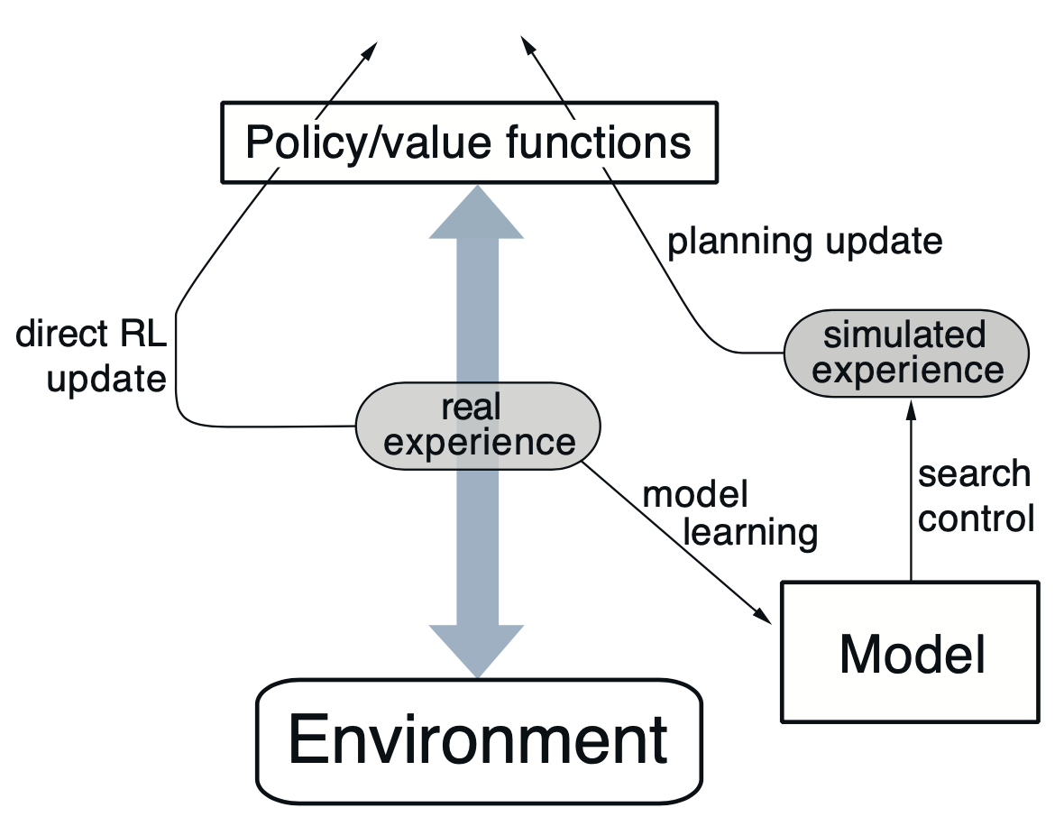
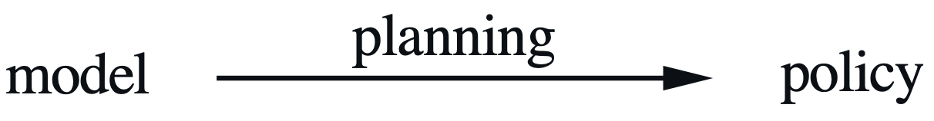
Optional Elements of RL
value functions for states or actions: improve efficiency of search in vast action policy space (alternative: direct policy search)
model of environment: (model-free) learning from trial-and-error or (model-based) planning
model of environment can be used in different ways:
simulate experience from model (for learning)
decision-time planning (e.g., heuristic search or model predictive control)
from Sutton

Slide 5
Markov Decision Process (MDP)
idea: current state includes all information about past
transition probabilities between states describe dynamics of given MDP
action policy: mapping from states to probabilities for selection of different actions

Slide 6
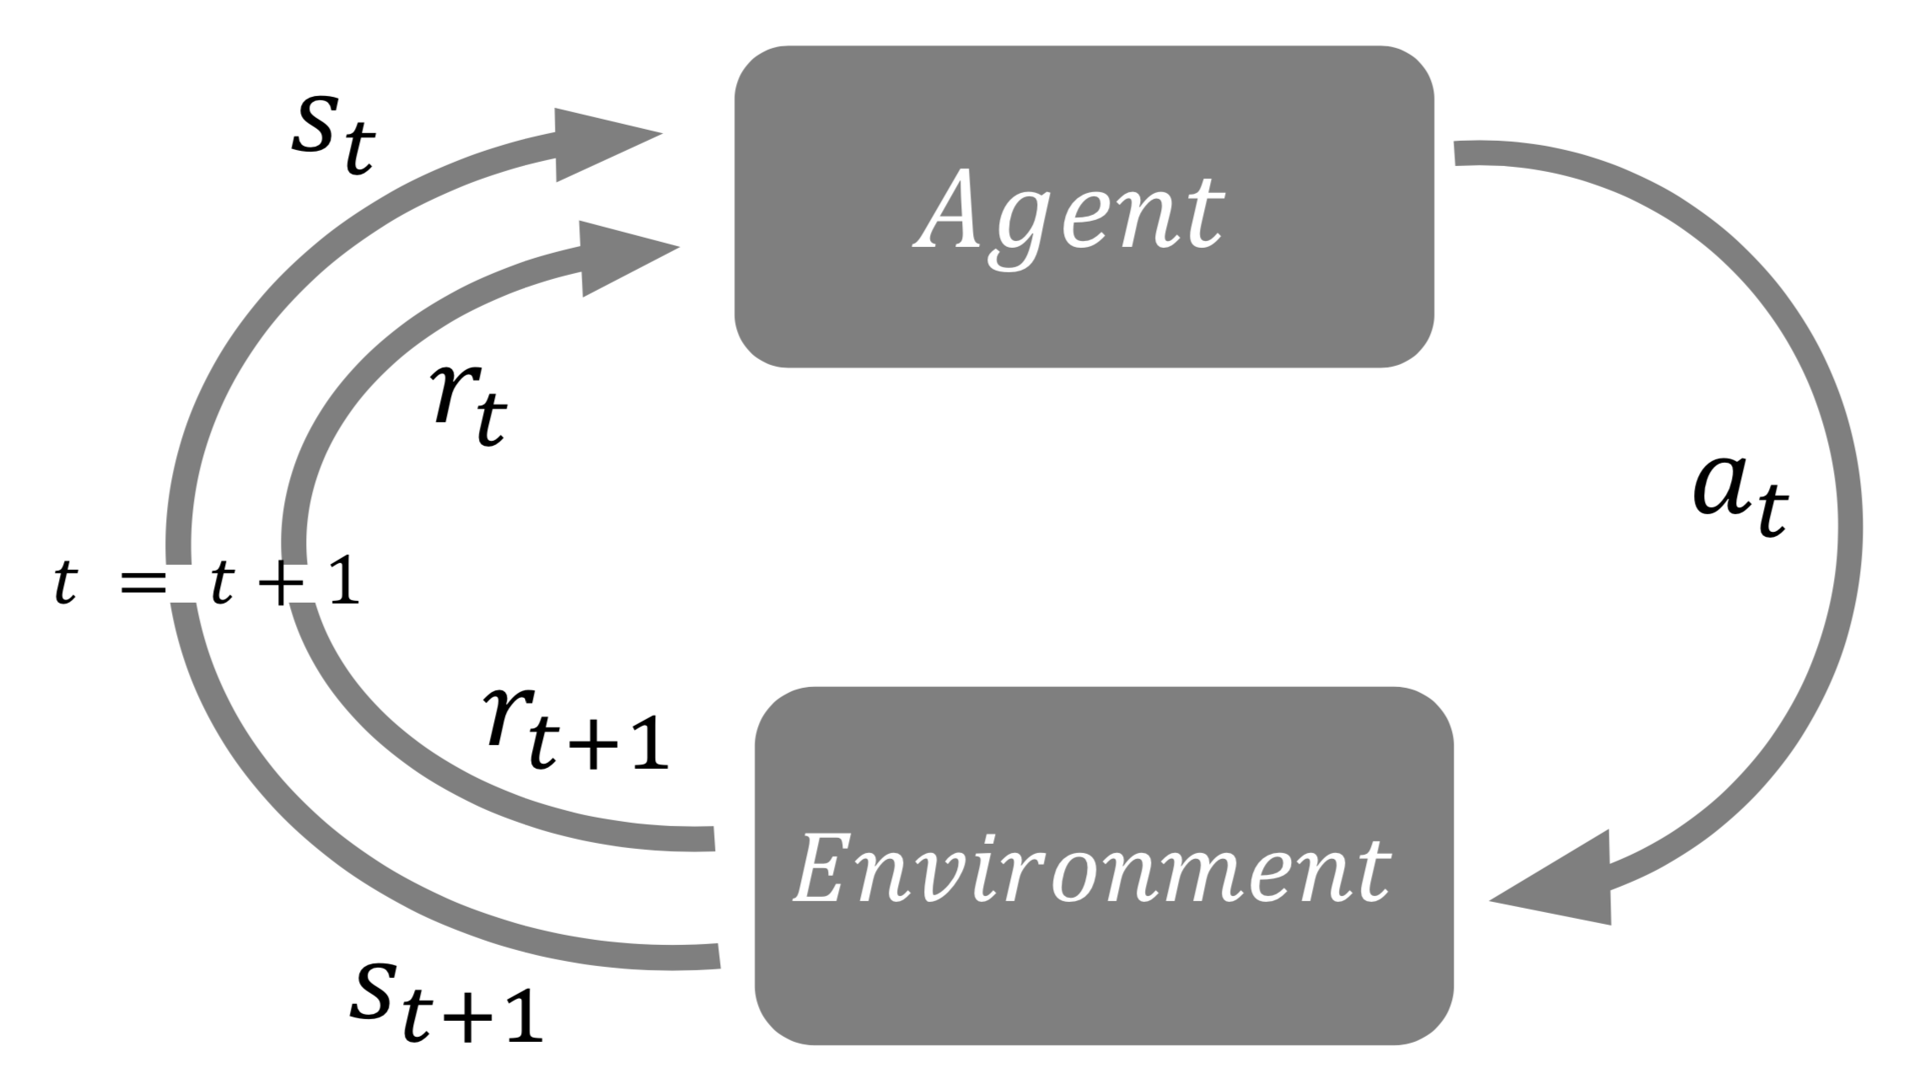

States, Actions, and Rewards
transition probabilities (model of environment): $p\left(s_{t+1},r_{t+1}|s_{t},a_{t}\right)$
reward hypothesis:
reward as scalar signal
goal: maximization of expected cumulative sum of received rewards

Slide 7
Value-Based Methods

Slide 8
State and Action Values
state/action value: total amount of expected future reward starting from given state/action (usually with discounting of later steps)
→ indicating long-term desirability of states/actions
main motivation: improve efficiency of search in policy space
(for comparison: evolutionary methods search directly by evaluating entire policies)

Slide 9
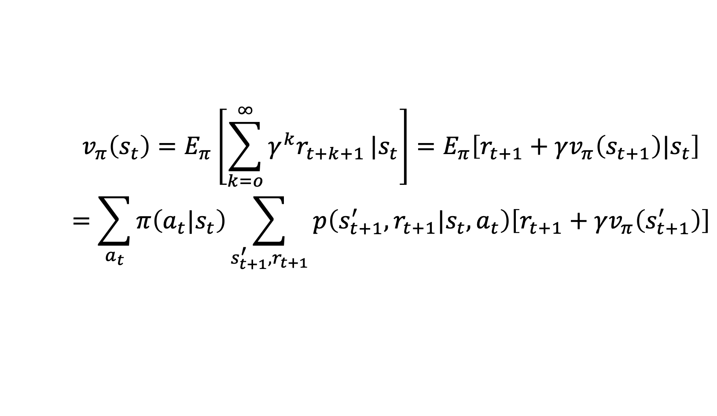
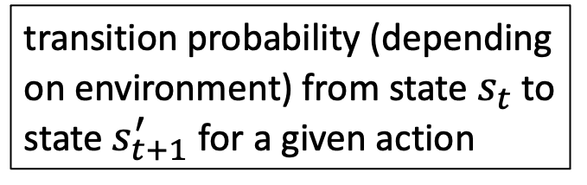
State-Value Function
return
discount rate
(needed for all states)
$$v_{π}\left(s_{t}\right)=E_{π}\left[\sum_{k=o}^{∞}{γ^{k}r_{t+k+1}}|s_{t}\right]=E_{π}\left[r_{t+1}+γv_{π}\left(s_{t+1}\right)|s_{t}\right]$$
$$=\sum_{a_{t}}{π\left(a_{t}|s_{t}\right)\sum_{s_{t+1}^{′},r_{t+1}}{p\left(s_{t+1}^{′},r_{t+1}|s_{t},a_{t}\right)\left[r_{t+1}+γv_{π}\left(s_{t+1}^{′}\right)\right]}}$$
policy: probabilitiy to take specific action being in a given state
transition probability (depending on environment) from state $s_{t}$ to state $s_{t+1}^{′}$for a given action
Bellman (expectation) equation: recursion
(sweep through entire state space)

Slide 10
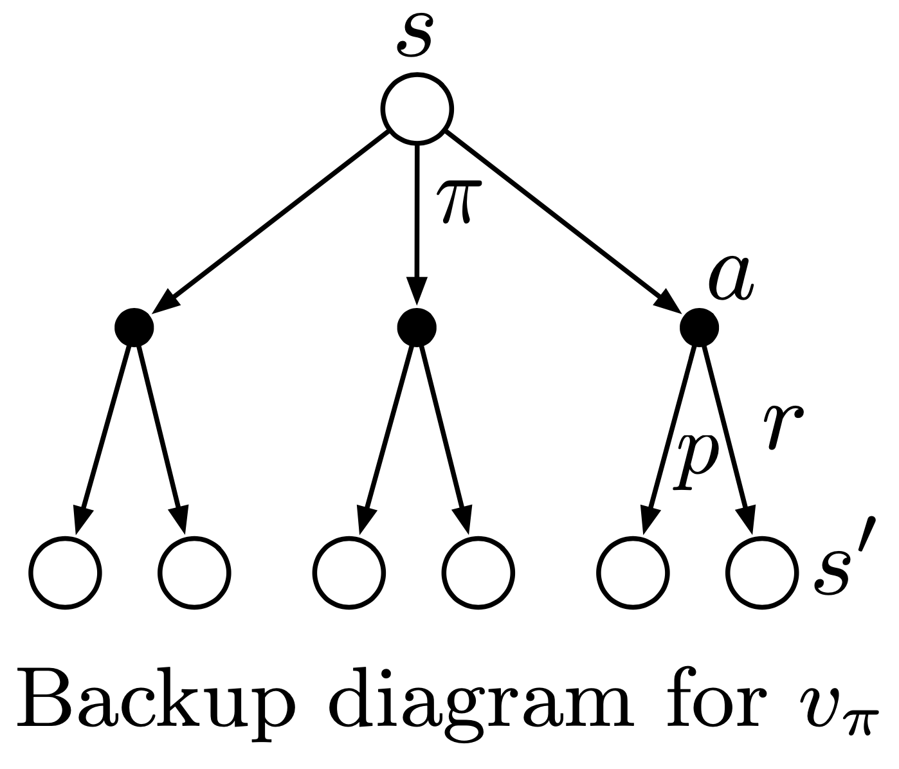
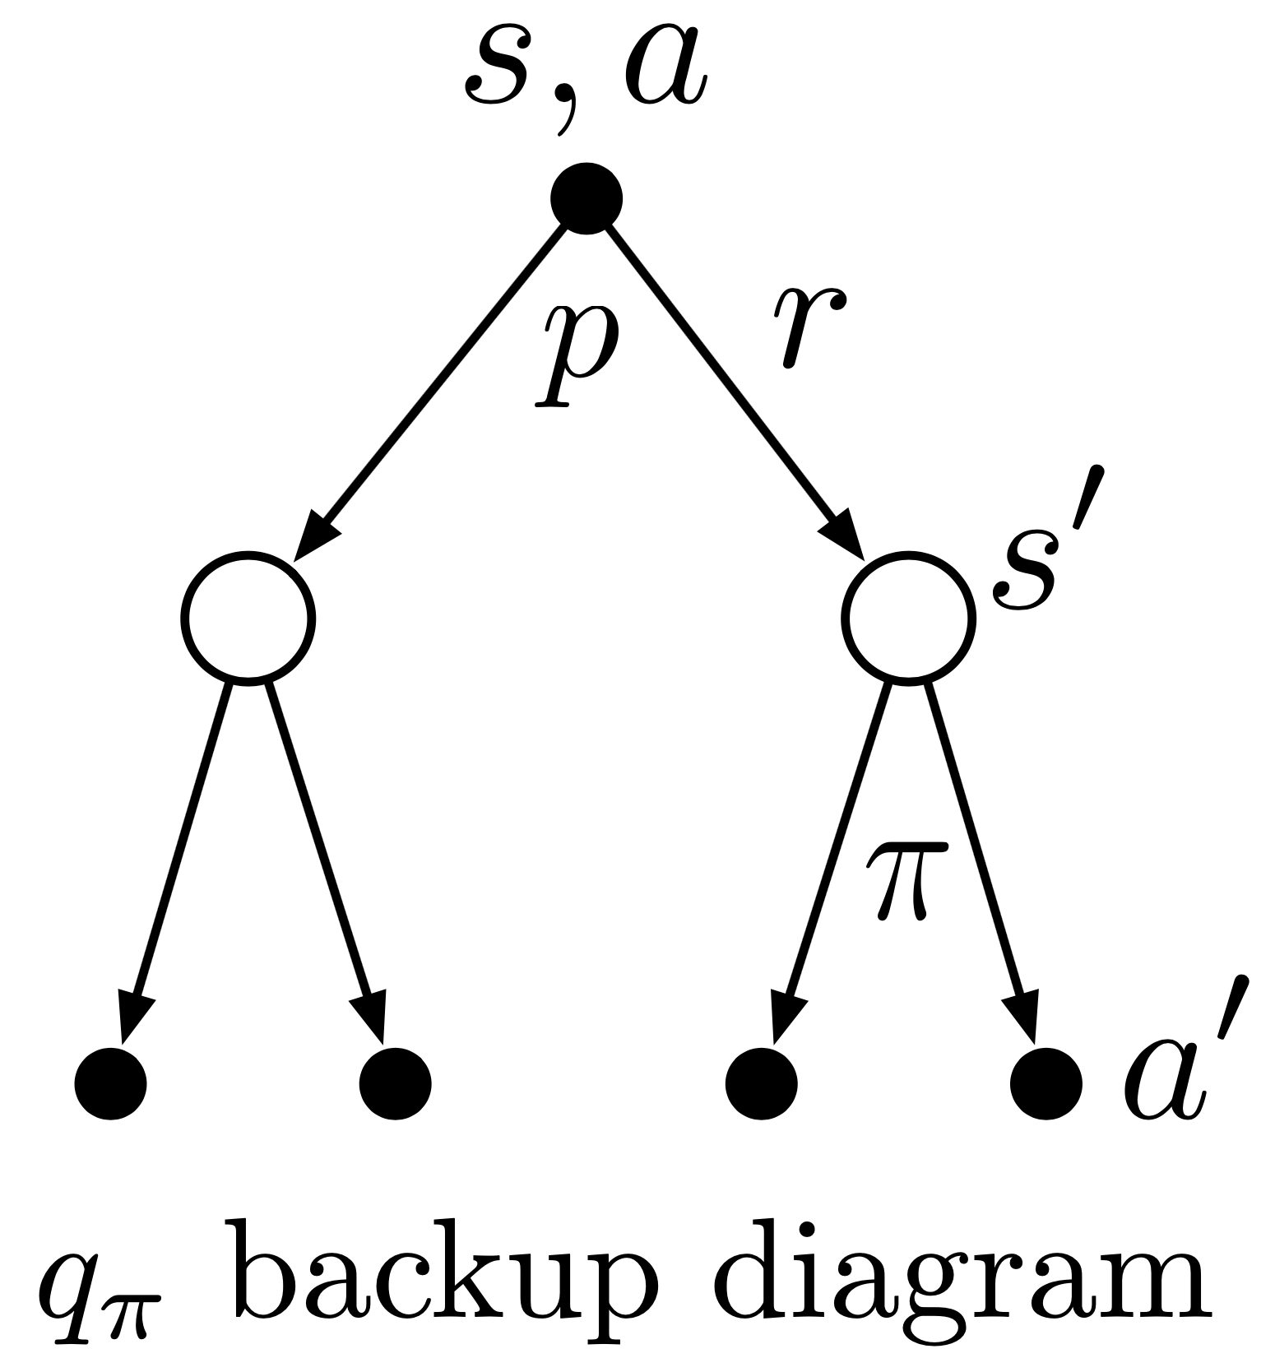
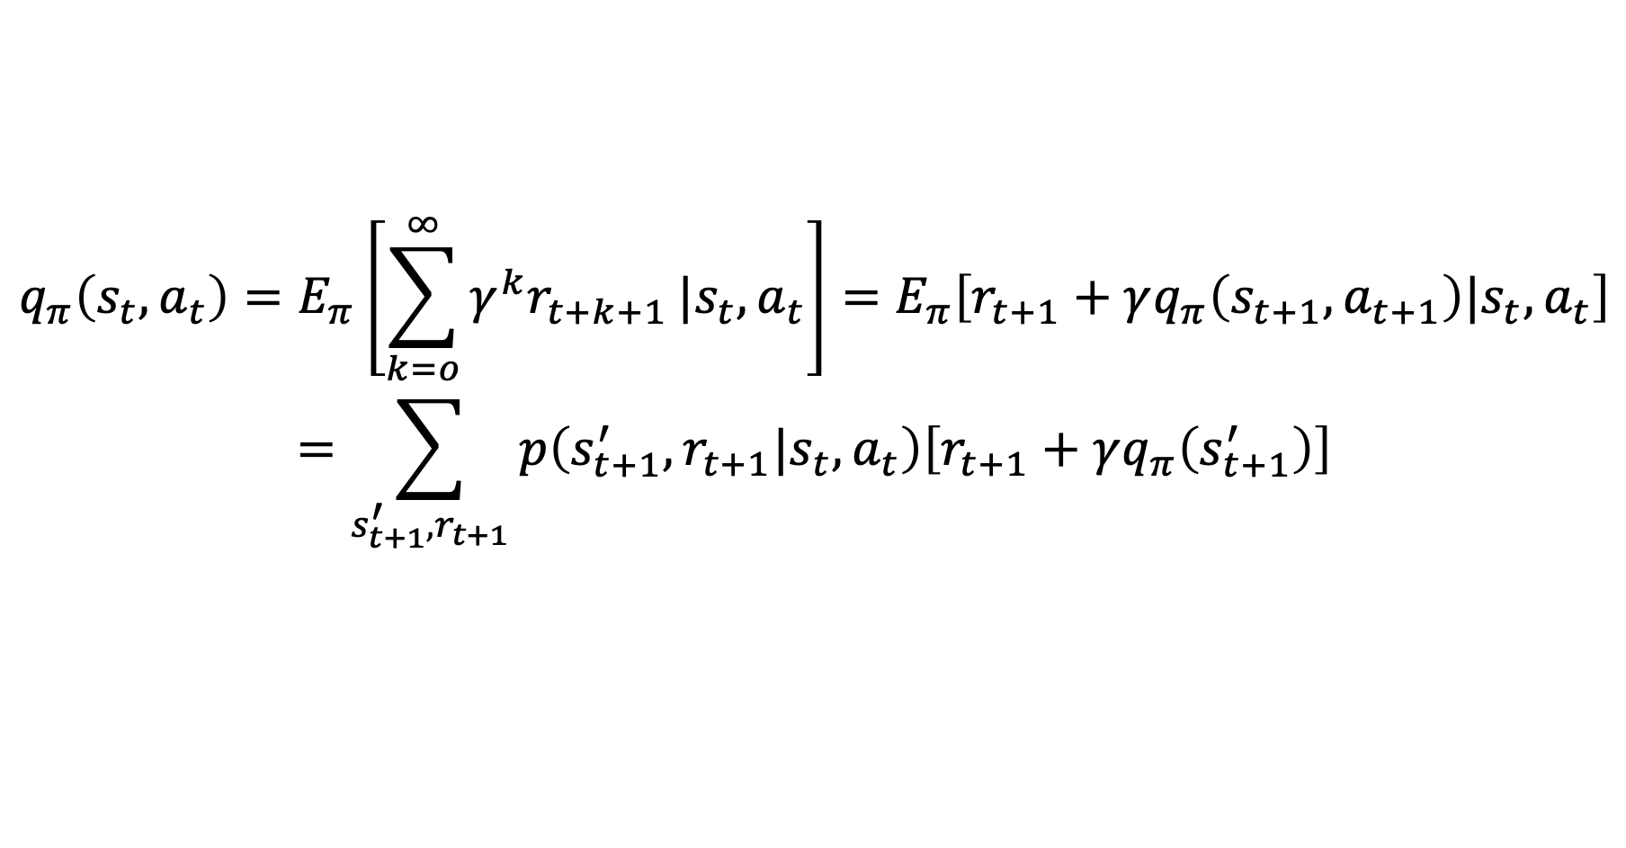
Action-Value Function
$$q_{π}\left(s_{t},a_{t}\right)=E_{π}\left[\sum_{k=o}^{∞}{γ^{k}r_{t+k+1}}|s_{t},a_{t}\right]=E_{π}\left[r_{t+1}+γq_{π}\left(s_{t+1},a_{t+1}\right)|s_{t},a_{t}\right]$$
$$=\sum_{s_{t+1}^{′},r_{t+1}}{p\left(s_{t+1}^{′},r_{t+1}|s_{t},a_{t}\right)\left[r_{t+1}+γq_{π}\left(s_{t+1}^{′}\right)\right]}$$
from Sutton

Slide 11
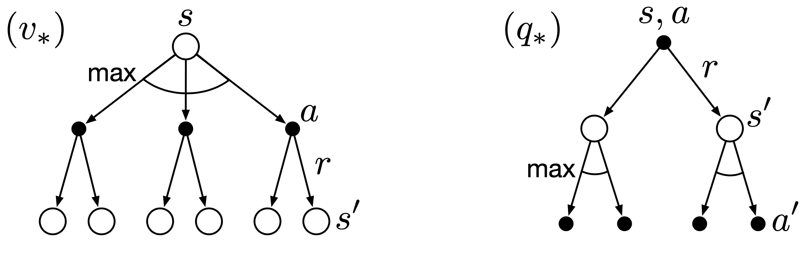
Bellman Optimality Equations
optimal solutions to Bellman equations (directly defining optimal policy):
rarely possible to find in practice (due to missing model of environment, invalid Markov property, limited computational resources)
→ approximate solutions
from Sutton

Slide 12
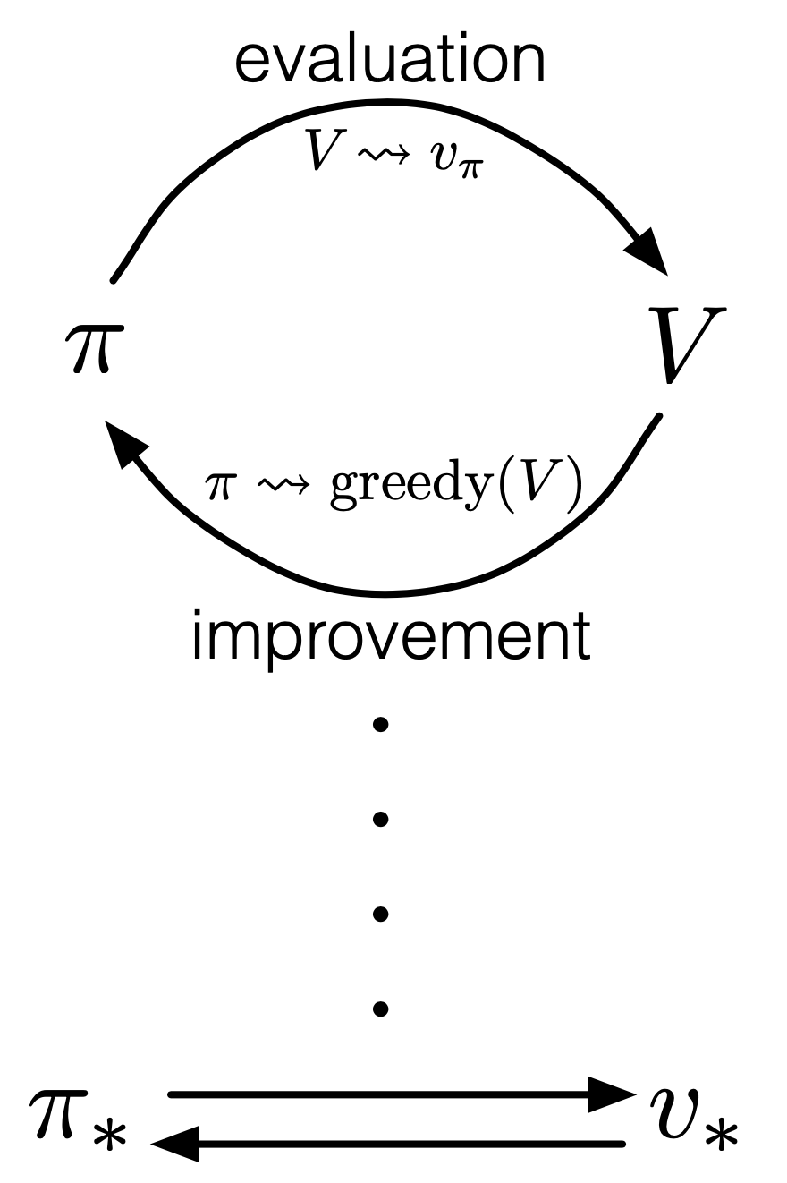

Dynamic Programming
generalized policy iteration (GPI):
iterative approaches to find approximations for optimal value functions
policy evaluation: calculate value function with current policy (Bellman equation as update rule)
policy improvement: adjusting policy to act greedy (pick actions with maximum values) with respect to value function of current policy
putting both components together:
policy iteration:
value iteration: truncated policy evaluation using Bellman optimality equation as update rule
from Sutton
GPI also followed by MC and TD methods …

Slide 13



Bootstrapping and Sampling
bootstrapping: update estimates of state values based on estimates of values of successor states
sampling: experience of sample sequences (no need for complete knowledge of environment)
Dynamic Programming
Temporal Difference (TD) Learning
Monte Carlo (MC)
from Sutton
bootstrapping
no sampling → model-based (transition probabilities needed)
bootstrapping
sampling → model-free
no bootstrapping
sampling → model-free

Slide 14

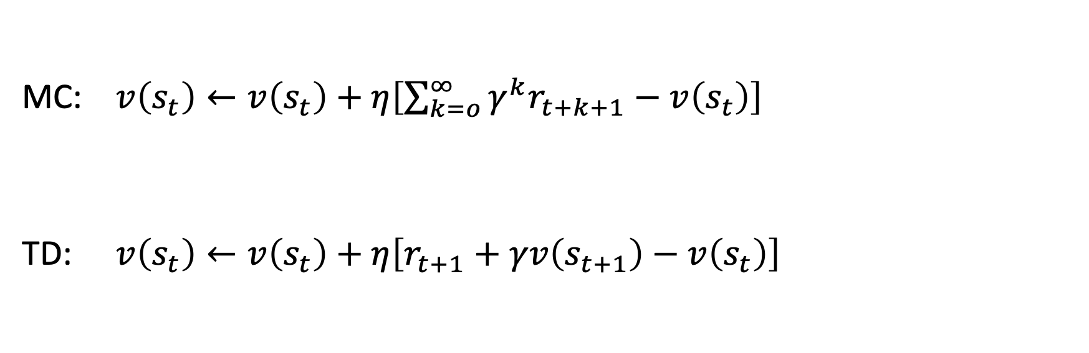
Sampling Update Rule
MC: $v\left(s_{t}\right)←v\left(s_{t}\right)+η\left[\sum_{k=o}^{∞}{γ^{k}r_{t+k+1}}−v\left(s_{t}\right)\right]$
TD: $v\left(s_{t}\right)←v\left(s_{t}\right)+η\left[r_{t+1}+γv\left(s_{t+1}\right)−v\left(s_{t}\right)\right]$
bootstrapping

Slide 15


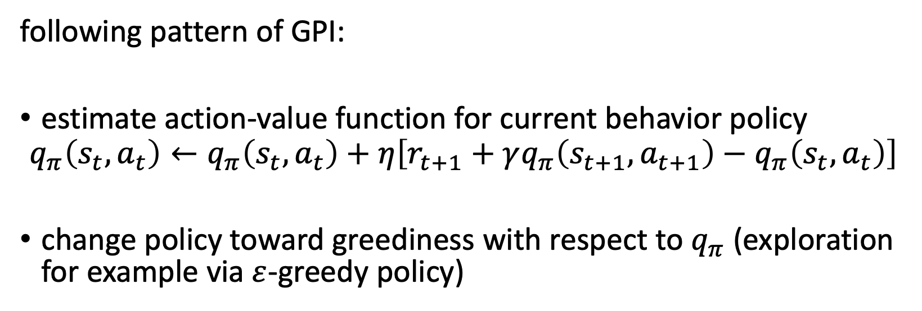
On-Policy TD Control: SARSA
S A R S A
from Sutton
following pattern of GPI:
estimate action-value function for current behavior policy
$$q_{π}\left(s_{t},a_{t}\right)←q_{π}\left(s_{t},a_{t}\right)+η\left[r_{t+1}+γq_{π}\left(s_{t+1},a_{t+1}\right)−q_{π}\left(s_{t},a_{t}\right)\right]$$
change policy toward greediness with respect to $q_{π}$ (exploration for example via $ε$-greedy policy)

Slide 16
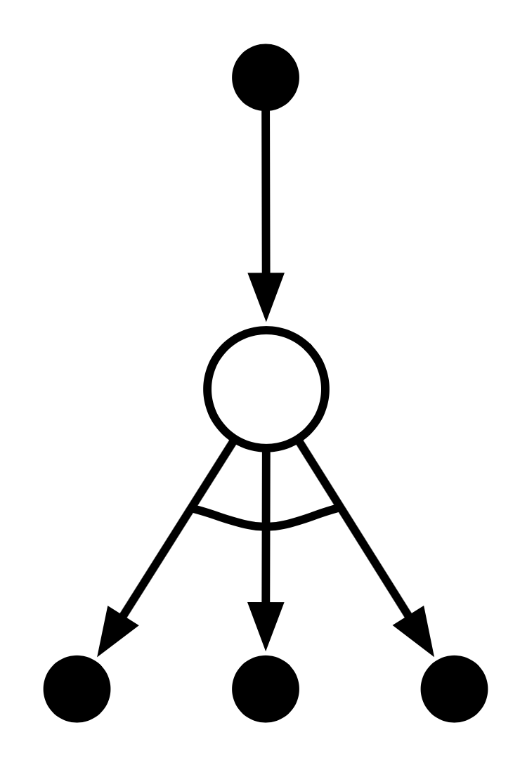
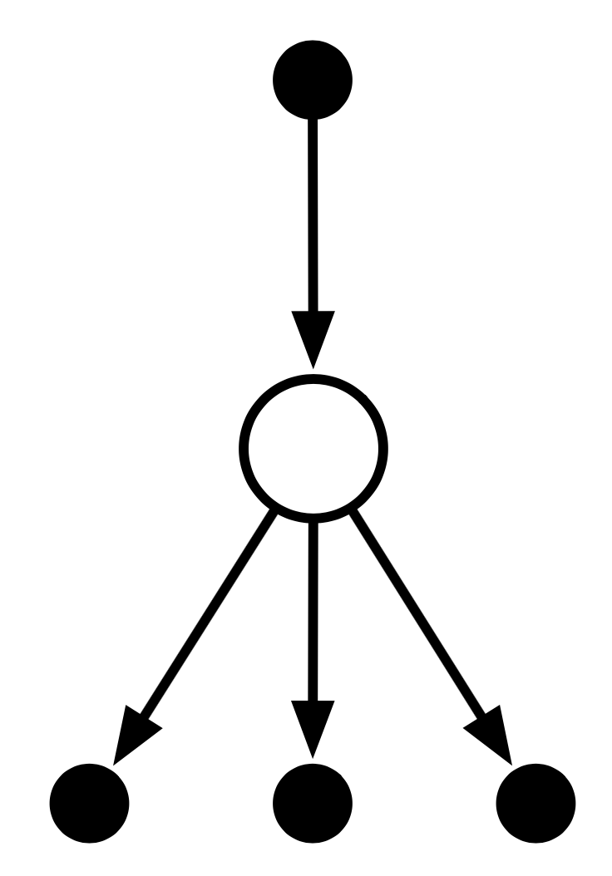
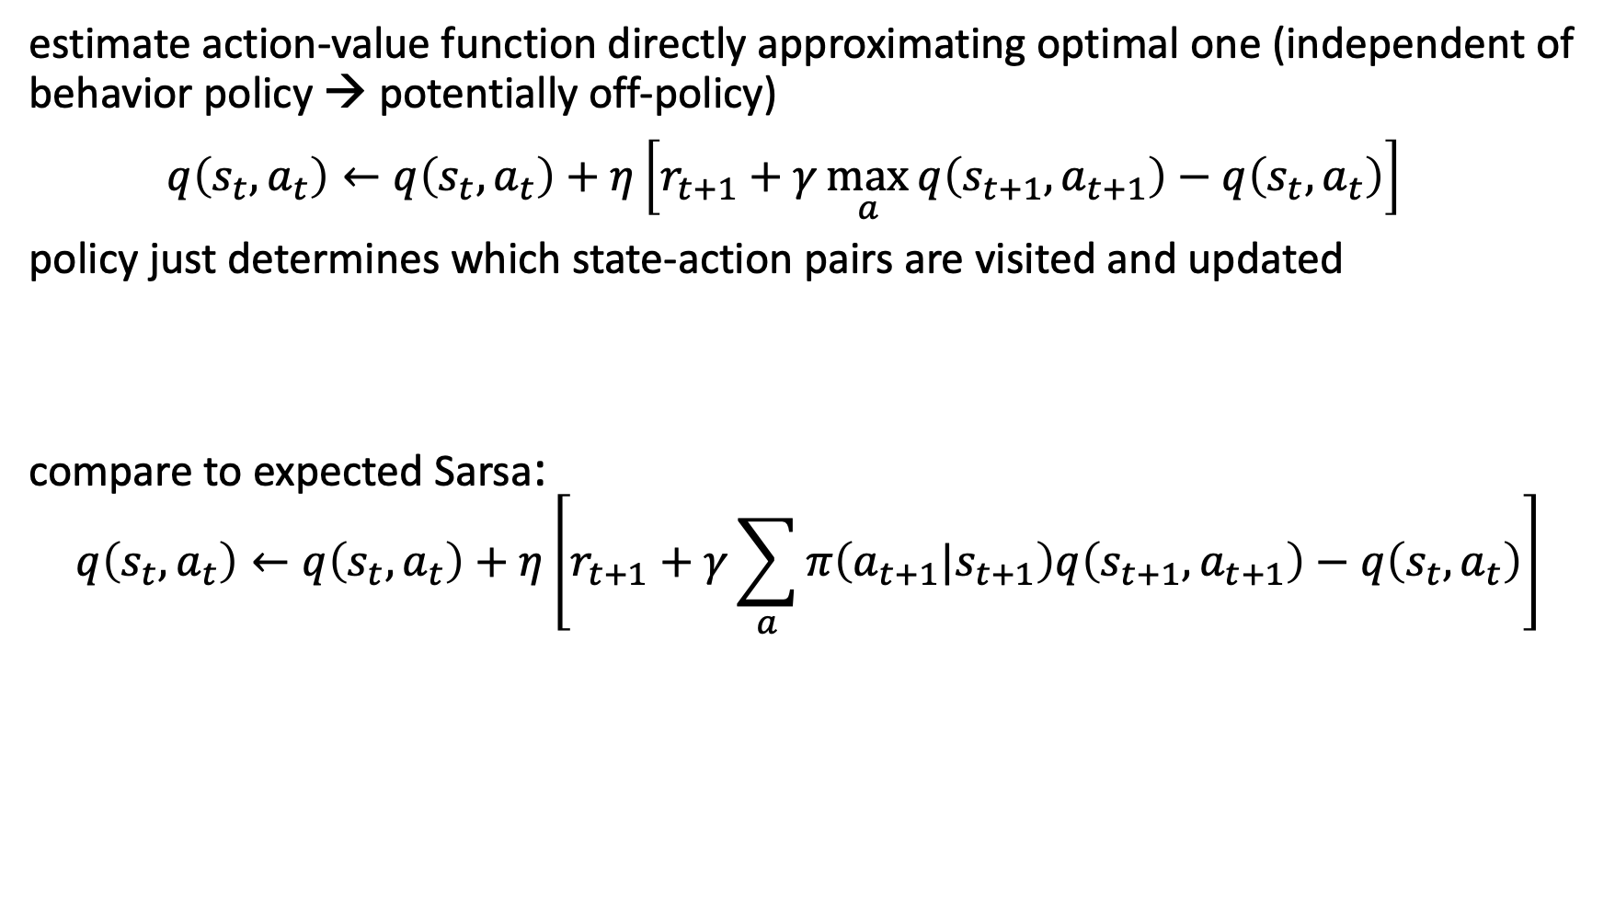
Off-Policy TD Control: Q-Learning
estimate action-value function directly approximating optimal one (independent of behavior policy → potentially off-policy)
$q\left(s_{t},a_{t}\right)←q\left(s_{t},a_{t}\right)+η\left[r_{t+1}+γ\max_{a}{q\left(s_{t+1},a_{t+1}\right)}−q\left(s_{t},a_{t}\right)\right]$
policy just determines which state-action pairs are visited and updated
compare to expected Sarsa:
$$q\left(s_{t},a_{t}\right)←q\left(s_{t},a_{t}\right)+η\left[r_{t+1}+γ\sum_{a}{π\left(a_{t+1}|s_{t+1}\right)q\left(s_{t+1},a_{t+1}\right)}−q\left(s_{t},a_{t}\right)\right]$$

Slide 17

Summary: Update Characteristics
one-step TD
reduce depth of search by bootstrapping with value function predicting future outcome
n-step TD
MC
from Sutton
reduce breadth of search by sampling actions from policy

Slide 18
Deep Reinforcement Learning

Slide 19
Limitation of Tabular Methods
tabular methods simply memorize observed data
problem with tabular solution methods in practice: large state/action spaces → curse of dimensionality
need for generalization: supervised learning to the rescue
non-linear function approximation
nowadays often deep learning methods → deep reinforcement learning

Slide 20
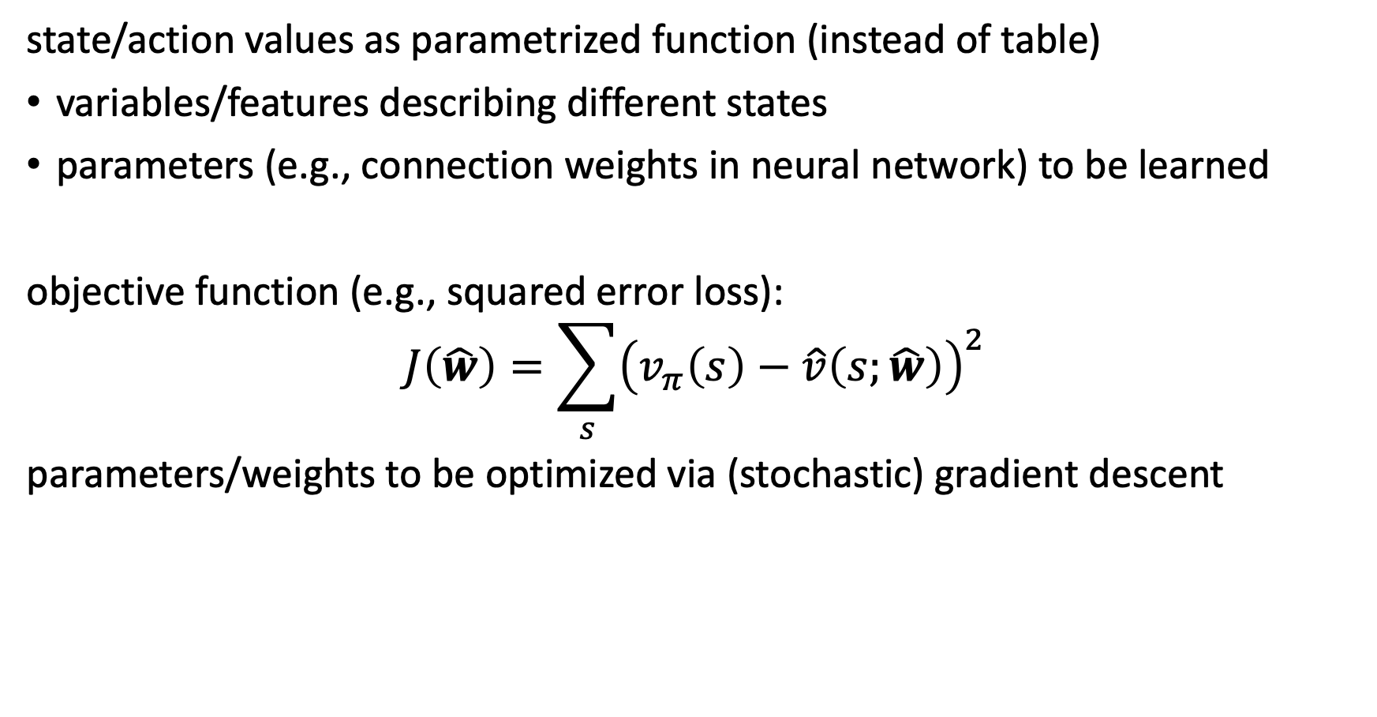
Approximate Solution Methods
state/action values as parametrized function (instead of table)
variables/features describing different states
parameters (e.g., connection weights in neural network) to be learned
objective function (e.g., squared error loss):
$$J\left(\hat{w}\right)=\sum_{s}{{\left(v_{π}\left(s\right)−\hat{v}\left(s;\hat{w}\right)\right)}^{2}}$$
parameters/weights to be optimized via (stochastic) gradient descent

Slide 21
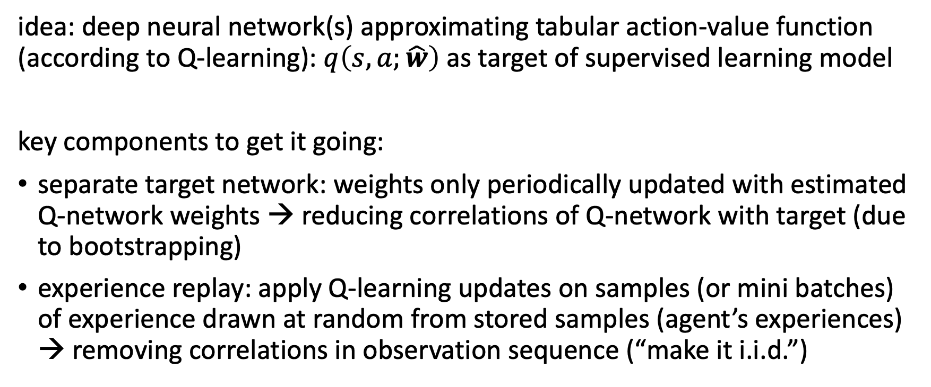
Deep Q-Network (DQN)
idea: deep neural network(s) approximating tabular action-value function (according to Q-learning): $q\left(s,a;\hat{w}\right)$ as target of supervised learning model
key components to get it going:
separate target network: weights only periodically updated with estimated Q-network weights → reducing correlations of Q-network with target (due to bootstrapping)
experience replay: apply Q-learning updates on samples (or mini batches) of experience drawn at random from stored samples (agent’s experiences) → removing correlations in observation sequence (“make it i.i.d.”)

Slide 22
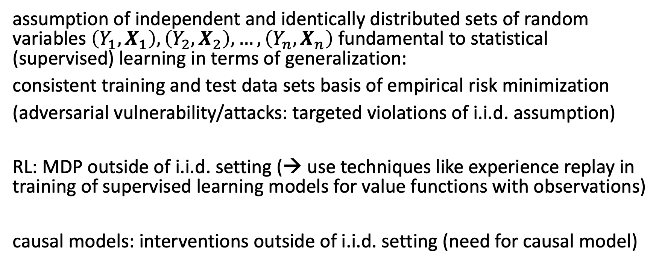
Side Note: i.i.d. Assumption in ML
assumption of independent and identically distributed sets of random variables $\left(Y_{1},X_{1}\right),\left(Y_{2},X_{2}\right),…, \left(Y_{n},X_{n}\right)$ fundamental to statistical (supervised) learning in terms of generalization:
consistent training and test data sets basis of empirical risk minimization
(adversarial vulnerability/attacks: targeted violations of i.i.d. assumption)
RL: MDP outside of i.i.d. setting (→ use techniques like experience replay in training of supervised learning models for value functions with observations)
causal models: interventions outside of i.i.d. setting (need for causal model)

Slide 23
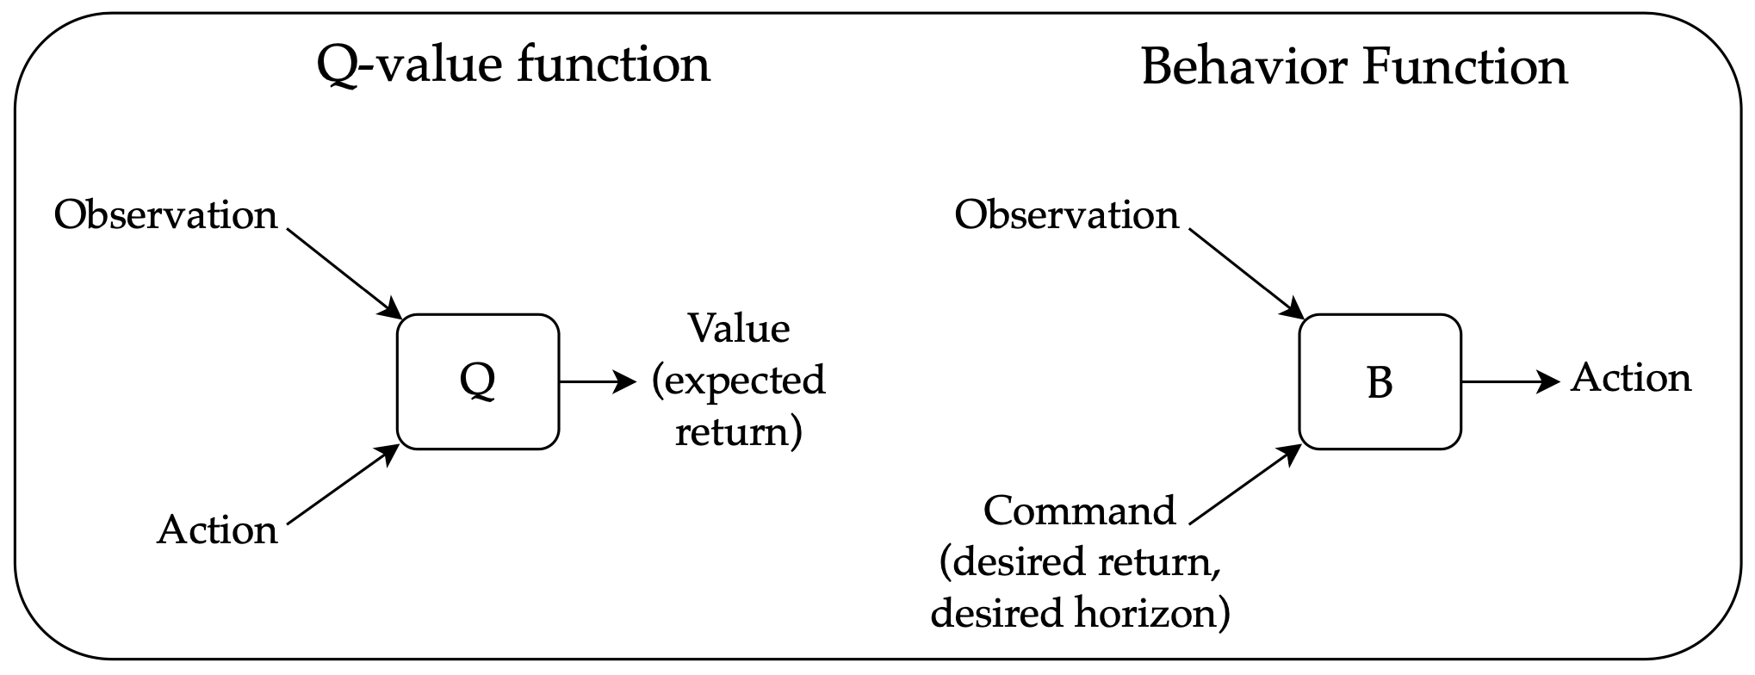
The Deadly Triad
issue in deep RL: combination of off-policy bootstrapping (e.g., Q-learning) with high-dimensional function approximation leads to non-stationary targets (unstable)
most popular technique to overcome this: target networks in DQN
alternative: upside–down RL → no bootstrapping
source

Slide 24
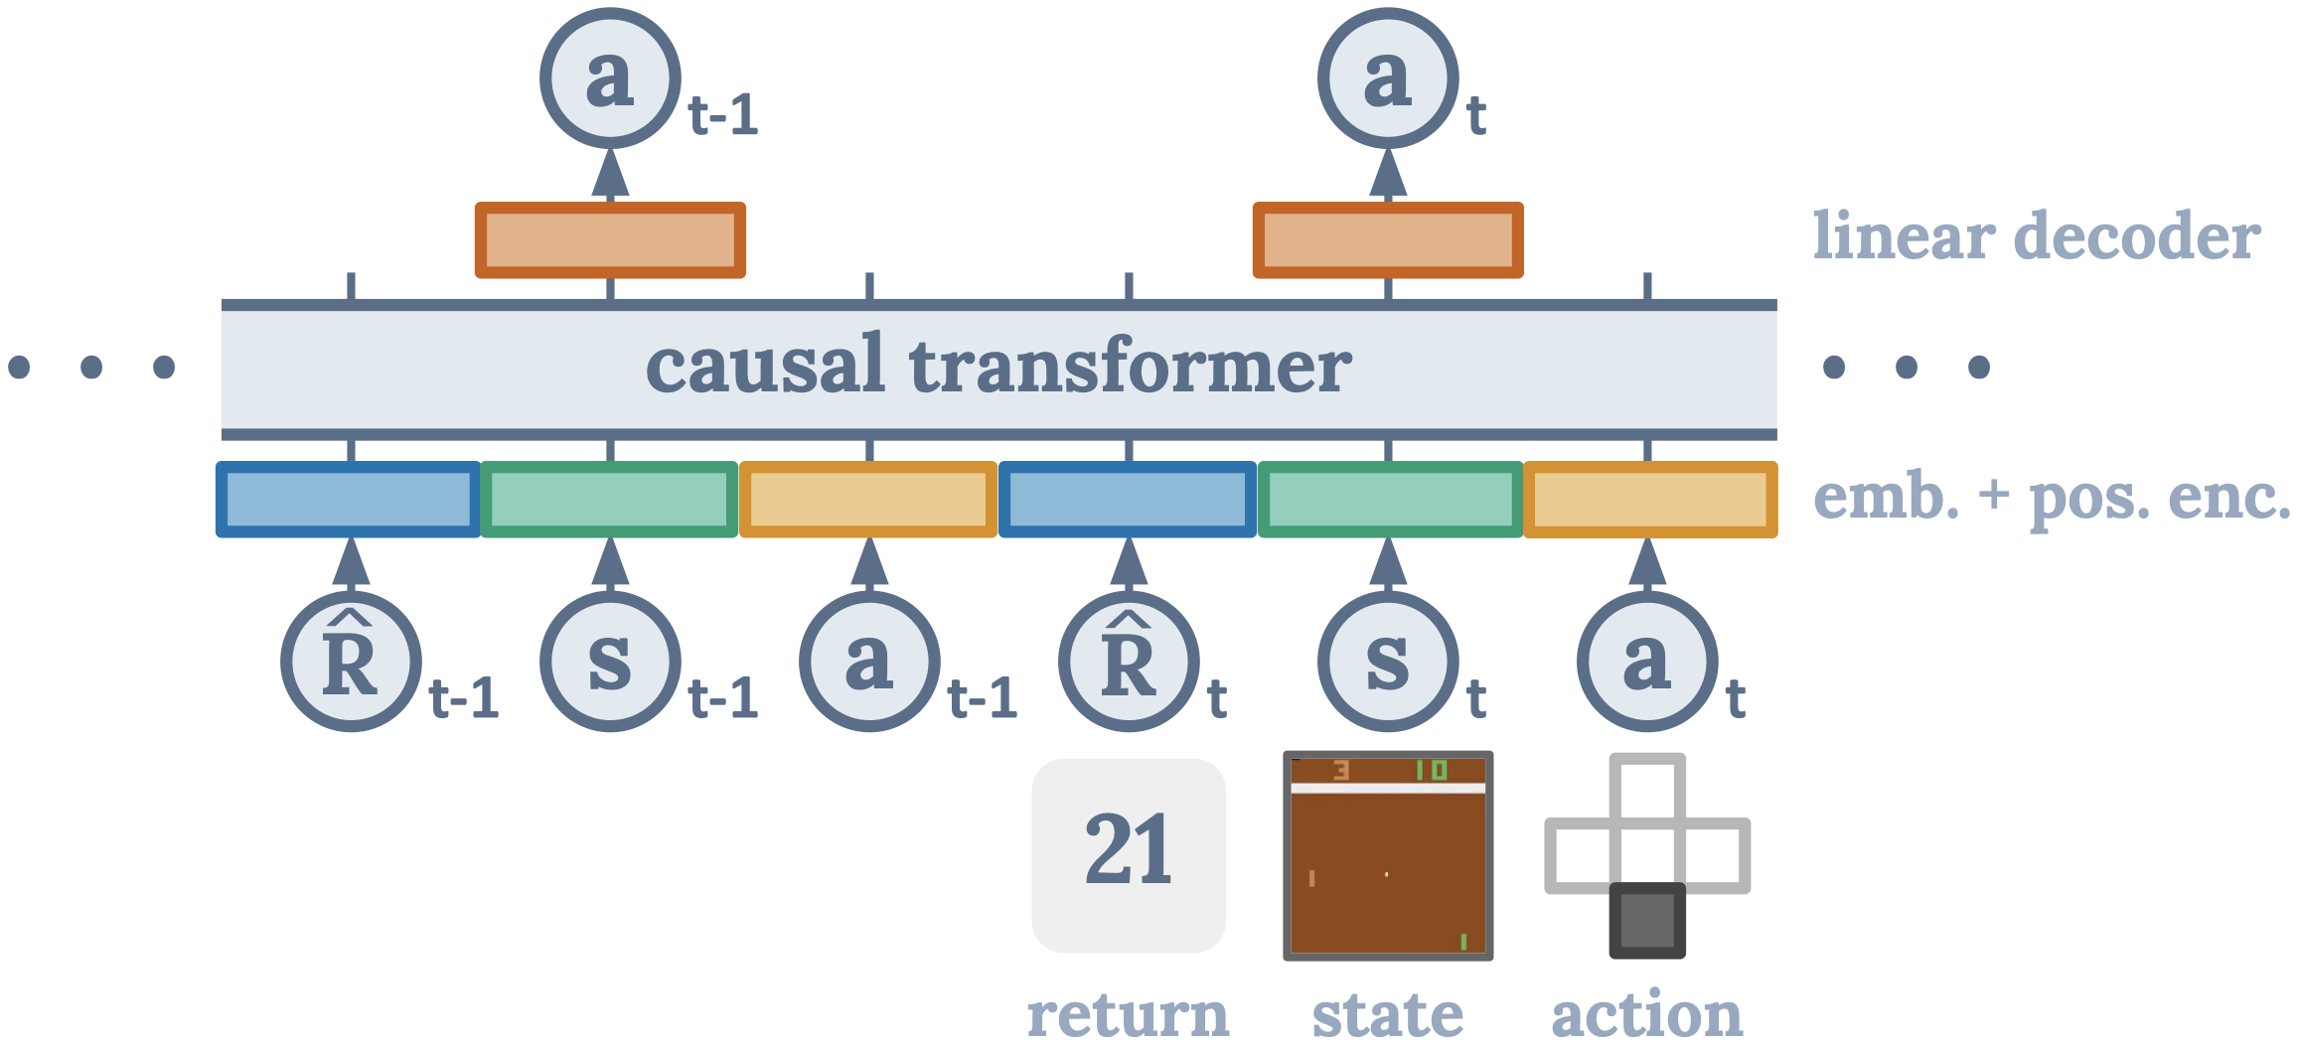
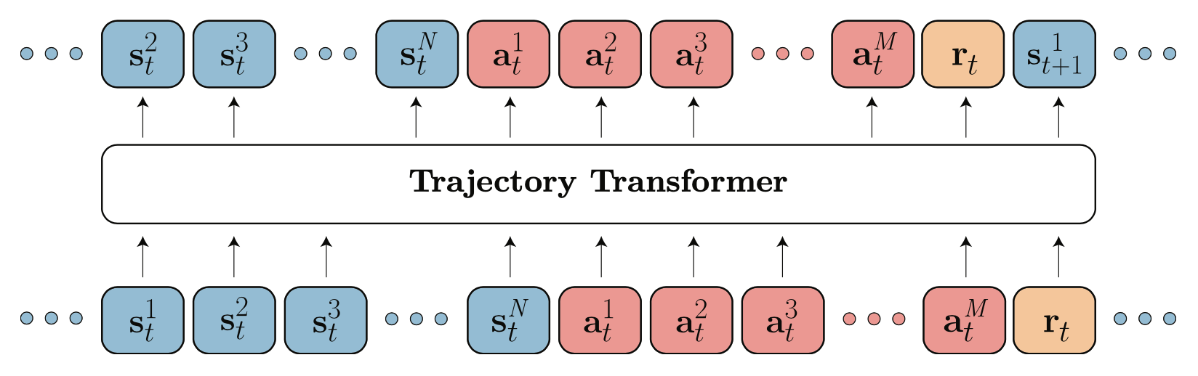
RL via Sequence Modeling
generative: transformer decoder architecture to autoregressively model trajectories
credit assignment directly via self-attention: implicitly forming state-return associations via similarity of query and key vectors (maximizing the dot product)
desired return tokens as prompt for action generation
Decision Transformer: conditioning on desired return, past states and actions to generate future actions
Trajectory Transformer: predicting also states and returns (adding model-based components, planning with beam search)
source
source

Slide 25
Direct Policy Search

Slide 26
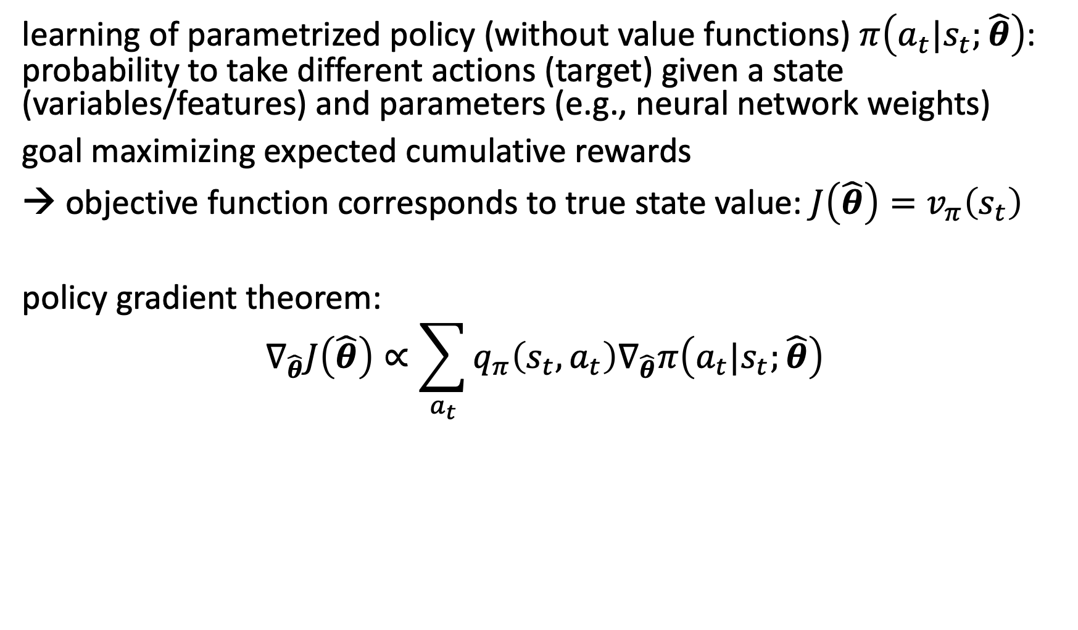
Policy Gradient Methods
learning of parametrized policy (without value functions) $π\left(a_{t}|s_{t};\hat{θ}\right)$: probability to take different actions (target) given a state (variables/features) and parameters (e.g., neural network weights)
goal maximizing expected cumulative rewards
objective function corresponds to true state value: $J\left(\hat{θ}\right)=v_{π}\left(s_{t}\right)$
policy gradient theorem:
$$∇_{\hat{θ}}J\left(\hat{θ}\right)∝\sum_{a_{t}}{q_{π}\left(s_{t},a_{t}\right)∇_{\hat{θ}}π\left(a_{t}|s_{t};\hat{θ}\right)}$$

Slide 27

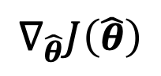
REINFORCE
REINFORCE method (MC method following from policy gradient theorem):
$$\hat{θ}←\hat{θ}+η∙∇_{\hat{θ}}\left[\log{π\left(a_{t}|s_{t};\hat{θ}\right)}\right]∙\left(r_{t+1}+γr_{t+2}+⋯\right)$$
policy gradients → neural network gradients
$$∇_{\hat{θ}}J\left(\hat{θ}\right)$$
“weighting” with observed (discounted) return

Slide 28
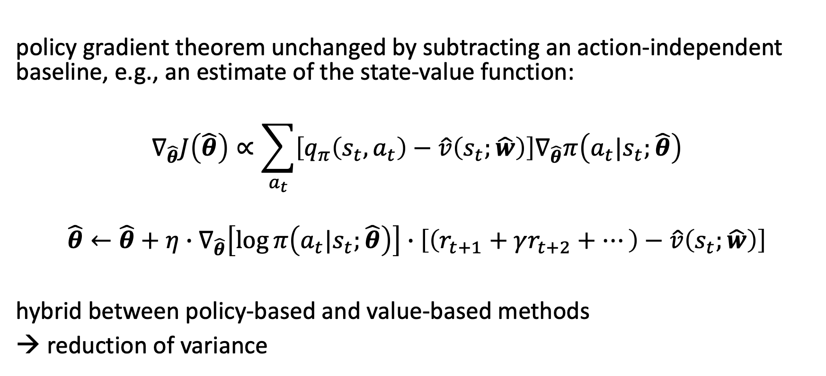
REINFORCE with Baseline
policy gradient theorem unchanged by subtracting an action-independent baseline, e.g., an estimate of the state-value function:
$$∇_{\hat{θ}}J\left(\hat{θ}\right)∝\sum_{a_{t}}{\left[q_{π}\left(s_{t},a_{t}\right)−\hat{v}\left(s_{t};\hat{w}\right)\right]∇_{\hat{θ}}π\left(a_{t}|s_{t};\hat{θ}\right)}$$
$$\hat{θ}←\hat{θ}+η∙∇_{\hat{θ}}\left[\log{π\left(a_{t}|s_{t};\hat{θ}\right)}\right]∙\left[\left(r_{t+1}+γr_{t+2}+⋯\right)−\hat{v}\left(s_{t};\hat{w}\right)\right]$$
hybrid between policy-based and value-based methods
→ reduction of variance
e.g., separate networks

Slide 29
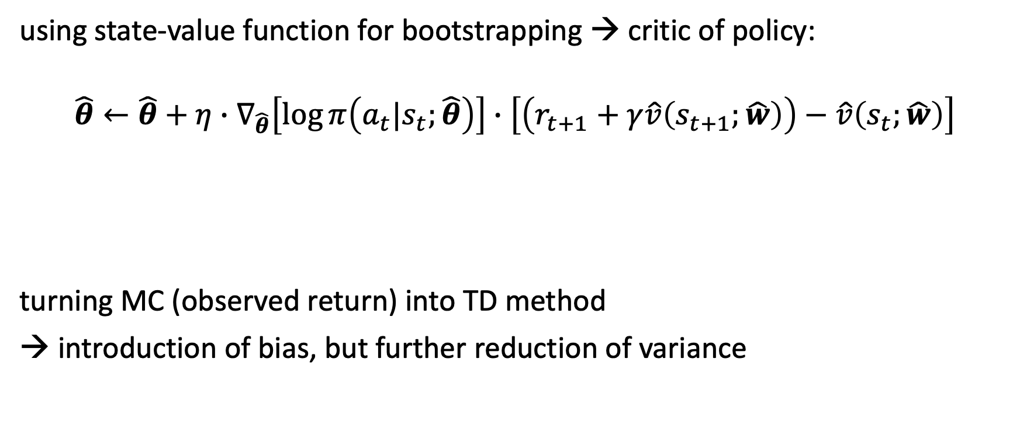
Actor-Critic Methods
using state-value function for bootstrapping → critic of policy:
$$\hat{θ}←\hat{θ}+η∙∇_{\hat{θ}}\left[\log{π\left(a_{t}|s_{t};\hat{θ}\right)}\right]∙\left[\left(r_{t+1}+γ\hat{v}\left(s_{t+1};\hat{w}\right)\right)−\hat{v}\left(s_{t};\hat{w}\right)\right]$$
turning MC (observed return) into TD method
→ introduction of bias, but further reduction of variance
TD error

Slide 30
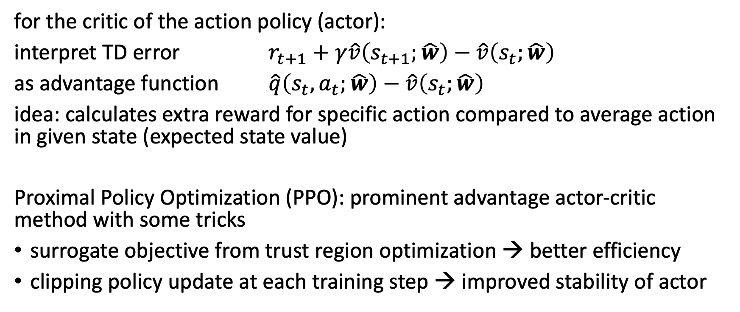
Synonym: Advantage Actor-Critic
for the critic of the action policy (actor):
interpret TD error $r_{t+1}+γ\hat{v}\left(s_{t+1};\hat{w}\right)−\hat{v}\left(s_{t};\hat{w}\right)$
as advantage function $\hat{q}\left(s_{t},a_{t};\hat{w}\right)−\hat{v}\left(s_{t};\hat{w}\right)$
idea: calculates extra reward for specific action compared to average action in given state (expected state value)
Proximal Policy Optimization (PPO): prominent advantage actor-critic method with some tricks
surrogate objective from trust region optimization → better efficiency
clipping policy update at each training step → improved stability of actor

Slide 31

RL from Human Feedback
example for supporting large language models (transformers) with RL
used in famous ChatGPT
goal: improve alignment with user intentions
→ learn from human preferences
source

Slide 32
Famous Example of Deep RL: AlphaGo
Monte Carlo tree search (heuristic search algorithm) for move (action) selection (focus on current state rather than full state space)
→ decision-time planning
guided by deep convolutional neural networks for both value function and policy estimation
→ improving search efficiency
reduce depth of search tree by evaluating positions with value function (predicting outcome from given position → bootstrapping)
reduce breath of search tree by sampling actions using policy network (probability distribution over possible moves in given position)

Slide 33

Literature
papers:
DQN, Atari
AlphaGo, AlphaGo Zero
PPO
pdf

Slide 34
Automation
one of most impactful goals of AI (e.g., get rid of repetitive tasks)
so far mainly for tasks in computer vision, NLP, but also structured data (e.g., automated replenishment)
next step: autonomous decision-making (e.g., autonomous driving, robotics)
support technology challenges like nuclear fusion plasma stabilization

